Slide 1

Sport Data Engineers: 2022 FIFA World Cup
Group: Solution_Makers
Dariel Ibanez
Nelson Velasco
Mia Serrano-Salow
Patricia Young

Slide 2
Purpose:
As sport data engineers, scouting companies can and would hire us when they are looking to buy 1 or more players for their team. In this case we were asked to look into the 2022 FIFA World Cup as a client was looking to purchase 1 or more players and wanted to look into some player stats.
We determined which players are the “best” based on their skills and performance in the 2022 FIFA World Cup.
We have defined “best” by analyzing the relationships between players’ number of goals, touches, assists, passes, etc.

Slide 3
Questions:
As sports data engineers working for scouting companies, some questions for this client we wanted to answer were:
What factors should determine what makes the players the “best”?
Who are the players that out performed their market value during the FIFA World Cup?
Who had the most number of goals out of all the players in the FIFA World Cup?
Which players had the most touches per the amount of minutes per game?

Slide 4
Applications Used:
Datasets that were used were found on Kaggle and were csv files.
The csv files were imported into Jupyter Notebook and ‘cleaned’. We transformed and cleaned the data in the Jupyter Notebook using both Pandas and Polars.
Next we exported the data as csv files and loaded into pgAdmin and created a database. We wanted to created several tables to be able to better manage to larger dataset.
We then exported the data back out of pgAdmin and back into the Jupyter Notebook to ensure things were working properly.

Slide 5
Notes:
Insert photos of cleaning data from csv file

Slide 6
Notes:
Insert photo of cleaning data from jupyter notebook

Slide 7
Notes:
Insert photo of ERD diagram

Slide 8
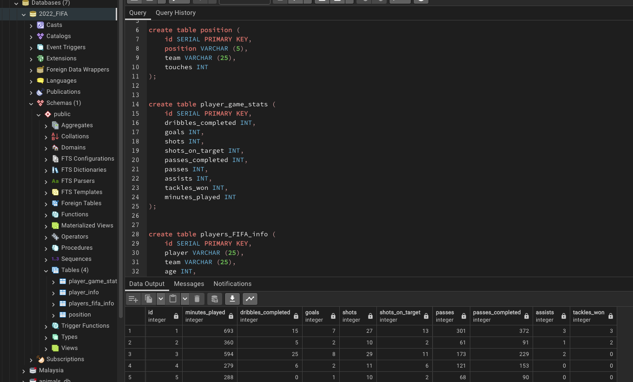
SQL Tables:
Notes:
Insert photo of SQL database/tables

Slide 9
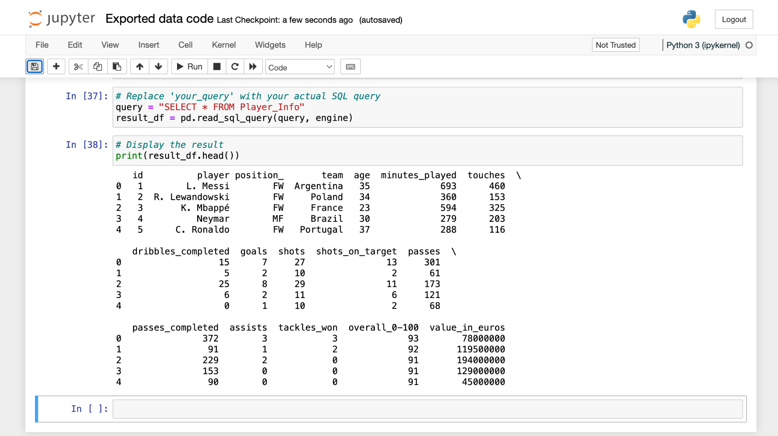
Exported Data:
Notes:
Insert photo of exported data check.

